Slide 1

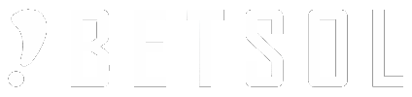
Container Management
&
The Kubernetes Platform

Slide 2
Container Management & the Kubernetes Platform
Orchestration Tools
Capabilities
Swarm vs Kubernetes vs Mesos
Kubernetes Introduction
Kubernetes Architecture
Kubernetes Parts & Components
DEMO: Kubernetes UI Overview + Creating & Running Pods

Slide 3
Tools Overview
Amazon ECS
Azure Container Service (ACS)
Cloud Foundry’s Diego
CoreOS Fleet
Docker Swarm
Google Container Engine
Kubernetes
Mesosphere Marathon

Slide 4
Capabilities
Networking
Scheduling
Scaling
Availability
Management
Upgrades
Service Discovery
Tool that can automate all aspects of application management from initial placement, scheduling and deployment to steady-state activities such as update, deployment, update and health monitoring functions that support scaling and failover

Slide 5

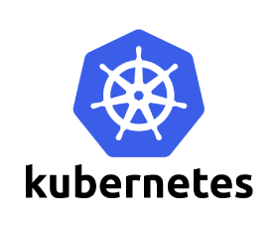

Swarm vs Kubernetes vs Mesos -1
In-house Docker orchestration solution
the most compatible and natural way to orchestrate docker container infrastructures.
Easy to integrate and setup, flexible API, but limited customization
Managers, Discovery, Worker, Services, Tasks
Offered by google and complex than swarm but it offers more features too
While a single master can control our complete setup
Highly versatile, large open-source dev community, but more expensive.
Master, Nodes, Pods, Deployment, Lables & Selectors, replication controller/ relica-set, services
Older than Docker and is a cluster platform which provides computing resources to frameworks like Marathon
Marathon can really do more than containers
Best for large—systems and designed for maximum redundancy
Master, Slaves, Service Discovery, Load Balancing, Constraints, Metrics, Applications

Slide 6
Swarm vs Kubernetes vs Mesos -2

Slide 7
Swarm vs Kubernetes vs Mesos -3

Slide 8
Kubernetes Introduction
What kubernetes can do
What kubernetes can’t do
Portable
public, private, hybrid,
multi-cloud
Extensible
modular, pluggable, hookable, composable
Self-healing
auto-placement, auto-restart, auto-replication, auto-scaling
Automated deployment and replication of containers
Scale-in or scale-out of container clusters
Load balancing over groups of containers
Rolling upgrades of application containers
Resilience, with automated rescheduling of failed containers
Controlled exposure of network ports to systems outside of the cluster
Perform the role of an all-inclusive PaaS (Platform as a Service) system
Limit the types of applications supported or dictate application frameworks, restrict the set of supported language runtimes, cater to only 12-factor applications, or distinguish apps from services.
Provide a click-to-deploy service marketplace
Deploy source code and build your application.

Slide 9
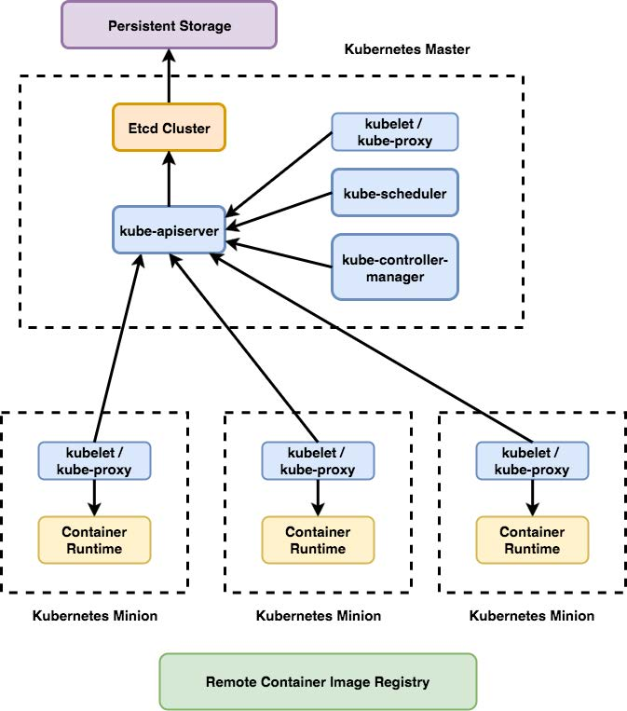
Kubernetes Introduction
Kubernetes Overview
Kubernetes is a production-grade, open-source infrastructure for the deployment, scaling, management, and composition of application containers across clusters of hosts.
More than just a “container orchestrator”.
Aims to eliminate the burden of orchestrating physical/virtual compute, network, and storage infrastructure.
Provides a stable platform for building customized workflows and higher-level automation.
Primarily targeted at applications composed of multiple containers.
Groups containers using pods and labels into tightly coupled and loosely coupled formations for easy management and discovery.

Slide 10
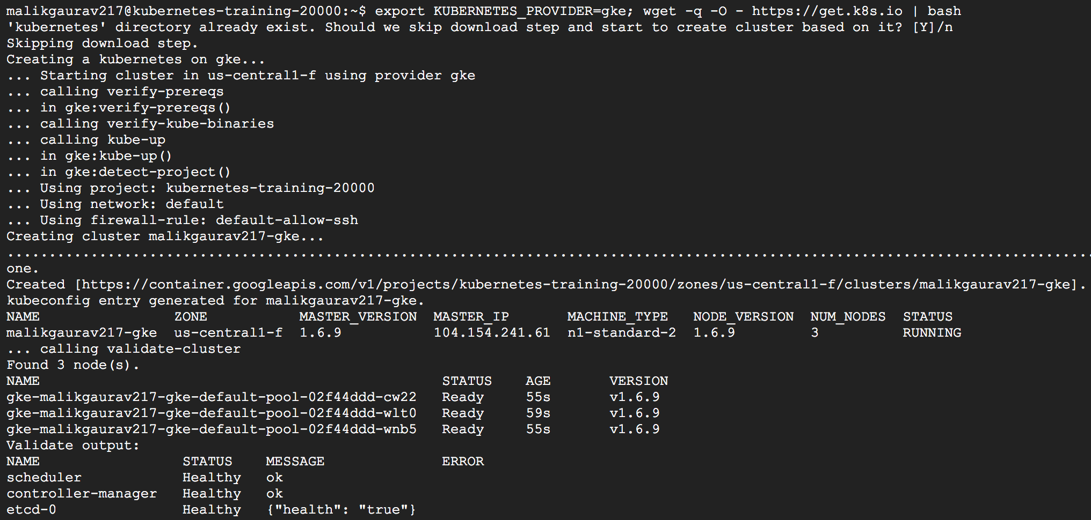
Kubernetes Setup
Setup 3 node Cluster on Google Container Engine
$ export KUBERNETES_PROVIDER=gke; wget -q -O - https://get.k8s.io | bash

Slide 11
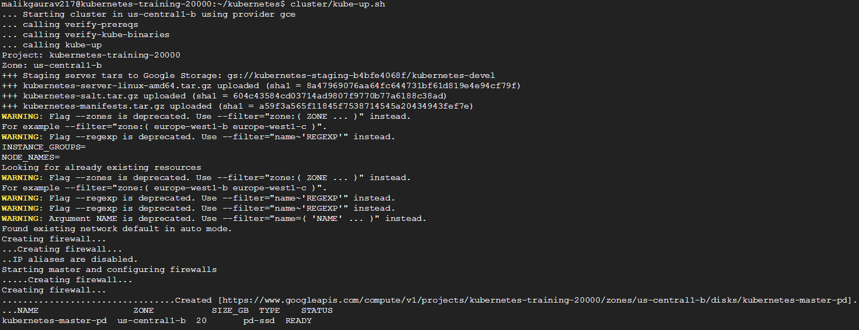
Kubernetes Setup
Get Kubernetes - $ curl -sS https://get.k8s.io | bash
Run kube-up.sh - $ sh kubernetes/cluster/kube-up.sh

Slide 12
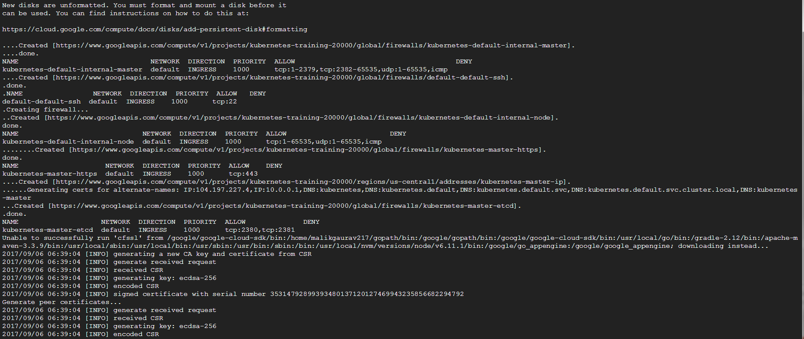
Kubernetes Setup
cluster/kube-up.sh

Slide 13
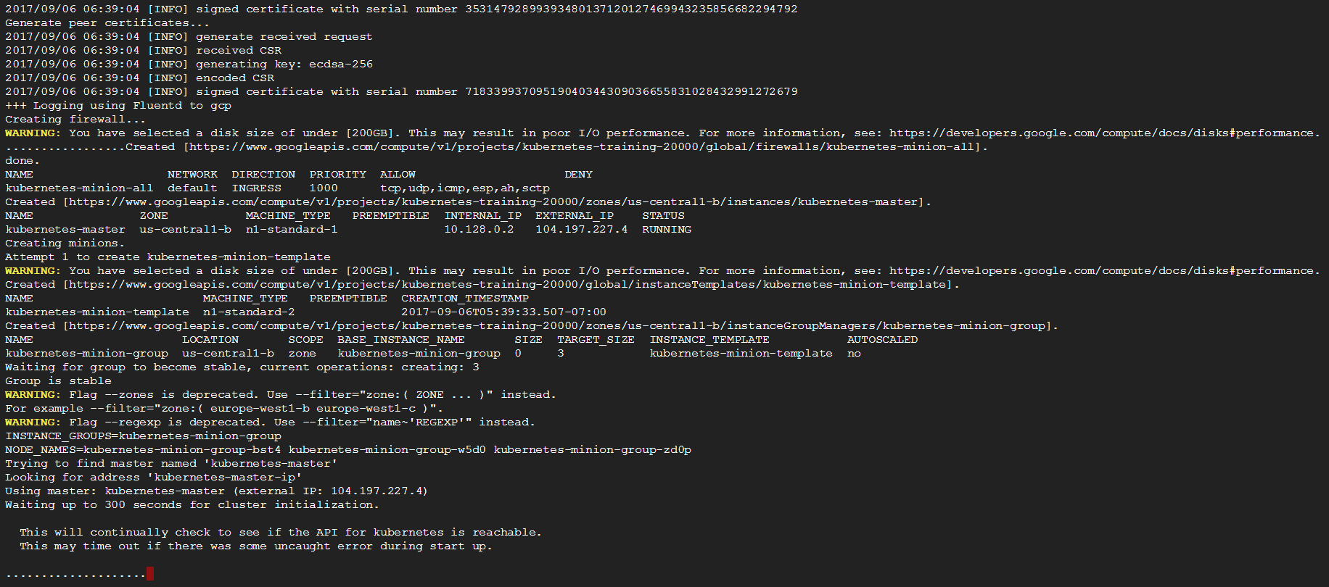
Kubernetes Setup
cluster/kube-up.sh

Slide 14
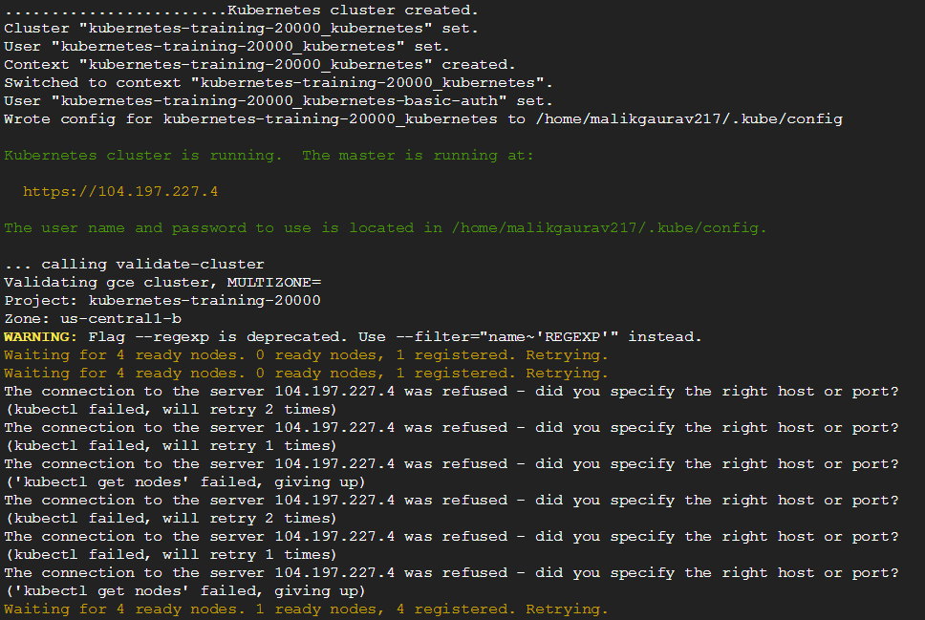
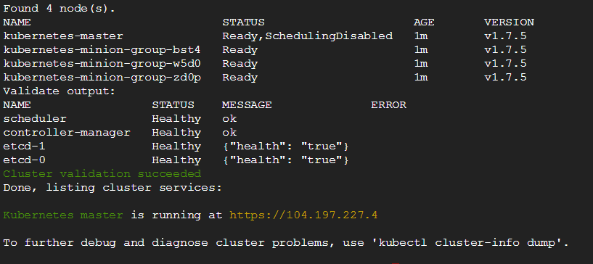
Kubernetes Setup
Logs:-
https://gist.githubusercontent.com/satnam6502/fc689d1b46db9772adea/raw/cf241fcfad1c7056a8e237bd5816eb1544e529a5/cluster_working.txt

Slide 15
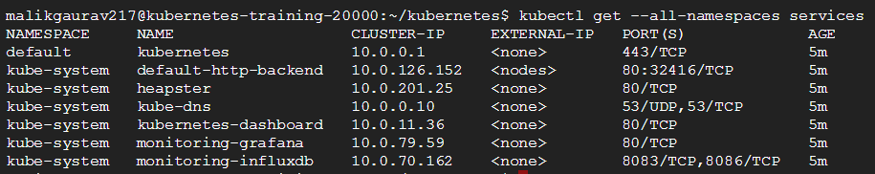
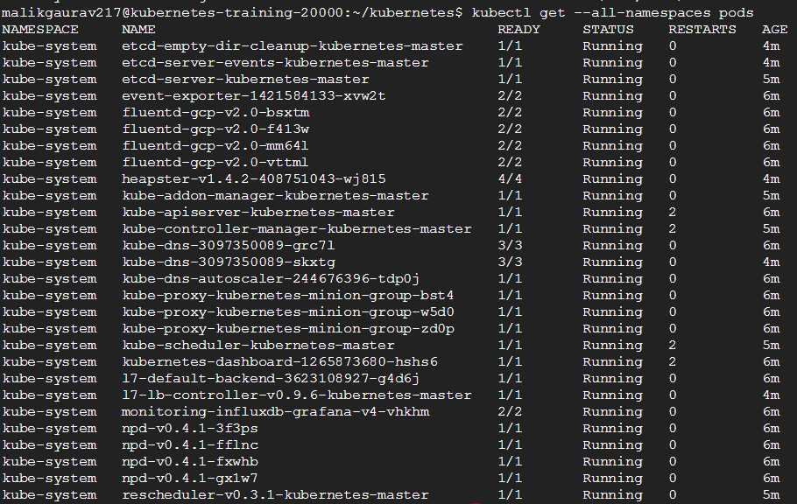
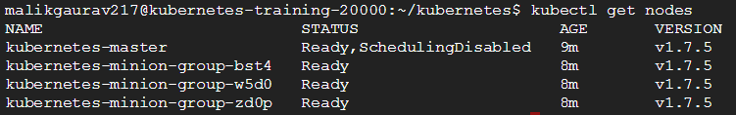
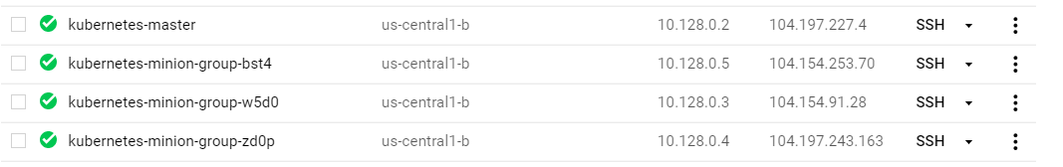
Kubernetes Setup
Get all service - $ kubectl get --all-namespaces services
Get all pods - $ kubectl get --all-namespaces pods
Get cluster nodes - $ kubectl get nodes

Slide 16
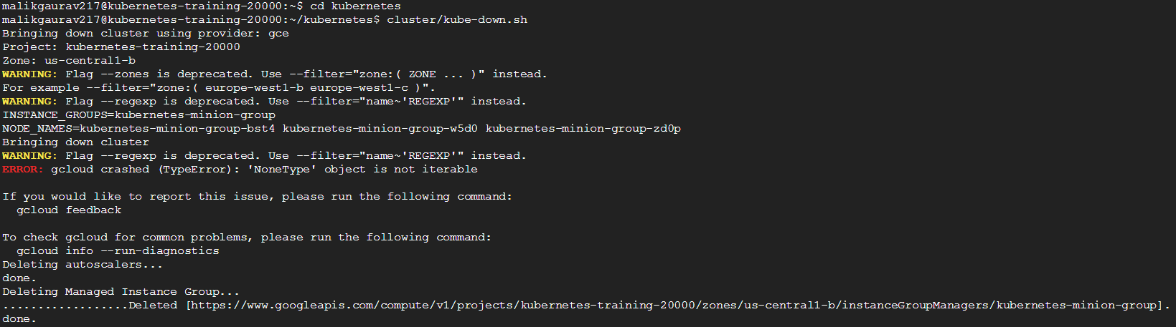
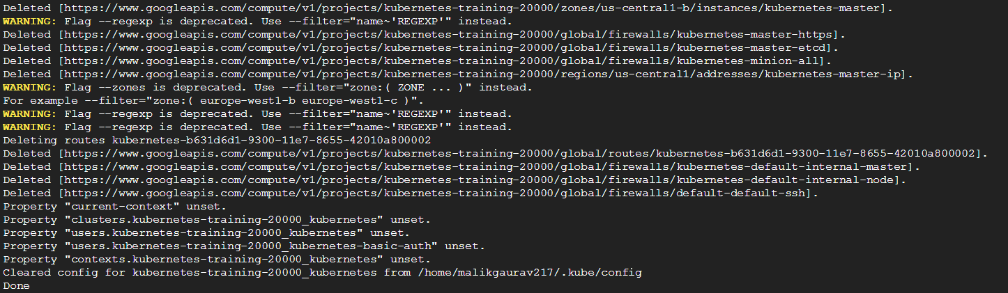
Kubernetes Setup
Understanding Containers
Delete cluster
$ sh cluster/kube-down.sh

Slide 17
Kubernetes Setup
Kubernetes master is running at https://35.197.86.189
GLBCDefaultBackend is running at https://35.197.86.189/api/v1/namespaces/kube-system/services/default-http-backend/proxy
Heapster is running at https://35.197.86.189/api/v1/namespaces/kube-system/services/heapster/proxy
KubeDNS is running at https://35.197.86.189/api/v1/namespaces/kube-system/services/kube-dns/proxy
kubernetes-dashboard is running at https://35.197.86.189/api/v1/namespaces/kube-system/services/kubernetes-dashboard/proxy

Slide 18
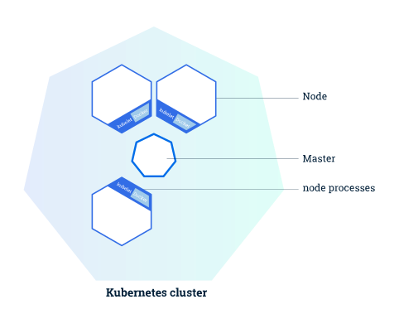
Kubernetes Parts & Components -1
Kubernetes cluster
Kubernetes coordinates a highly available cluster of computers that are connected to work as a single unit.
The abstractions allow deployment of containerized applications to a cluster without tying them specifically to individual machines.
Applications need to be packaged in a way that decouples them from individual hosts i.e. be containerized.
Containerized applications are more flexible and available than in past deployment models.
Kubernetes automates the distribution and scheduling of application containers across a cluster in a more efficient way.
A running Kubernetes cluster contains node agents (kubelet) and a cluster control plane (AKA master), with cluster state backed by a distributed storage system (etcd)

Slide 19
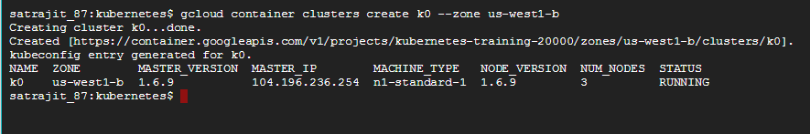
Kubernetes Demo – Create Cluster
Create a Kubernetes Cluster
gcloud container clusters create k0 –zone us-west1-b

Slide 20
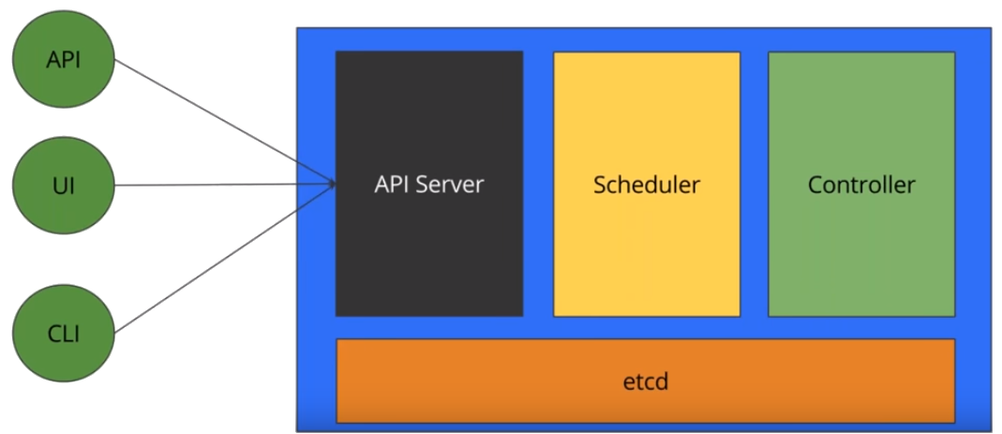
Kubernetes Parts & Components -1
Kubernetes Master
Cluster Control Plane (AKA master)
The Kubernetes control plane is split into a set of components.
Components can all run on single master node, or can be replicated to support high-availability clusters, or be self-hosted.
Kubernetes provides a REST API supporting primarily CRUD operations on (mostly) persistent resources, which serve as the hub of its control plane.
Kubernetes’s API provides
IaaS-like container-centric primitives such as Pods, Services, and Ingress,
Lifecycle APIs to support orchestration of common types of workloads, such as ReplicaSet, Deployment, Job, CronJob, DaemonSet, and StatefulSet.
Service naming/discovery and load balancing is decoupled from application implementation.
Both user clients and components containing asynchronous controllers interact with the same API resources, which serve as coordination points, common intermediate representation, and shared state.
Most resources contain metadata, including labels and annotations, fully elaborated desired state (spec), including default values, and observed state (status).
Controllers work continuously to drive the actual state towards the desired state, while reporting back the currently observed state for users and for other controllers.
While the controllers are level-based to maximize fault tolerance, they typically watch for changes to relevant resources in order to minimize reaction latency and redundant work.
This enables decentralized and decoupled choreography-like coordination without a message bus.

Slide 21
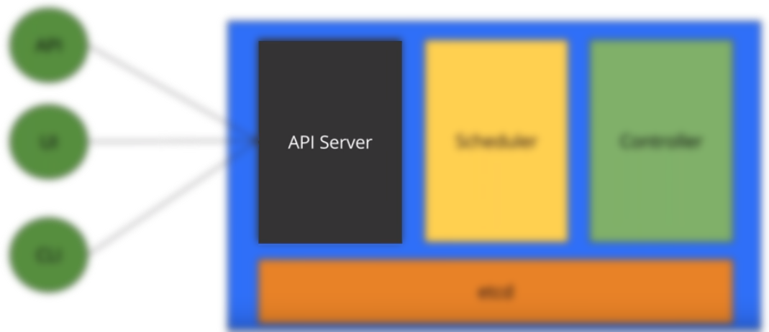
Kubernetes Parts & Components -1
Kubernetes Master
API Server
The API server serves up the Kubernetes API
Relatively simple server, with most/all business logic implemented in separate components or in plug-ins.
Processes REST operations, validates them, and updates the corresponding objects in etcd (and eventually other stores).
Includes:
REST semantics, watch, durability and consistency guarantees, API versioning, defaulting, and validation
Built-in admission-control semantics, synchronous admission-control hooks, and asynchronous resource initialization
API registration and discovery
API server acts as the gateway to the cluster.
API server must be accessible by clients from outside the cluster
The nodes, and certainly containers, may not be.
Clients authenticate the API server and also use it as a bastion and proxy/tunnel to nodes and pods (and services).

Slide 22
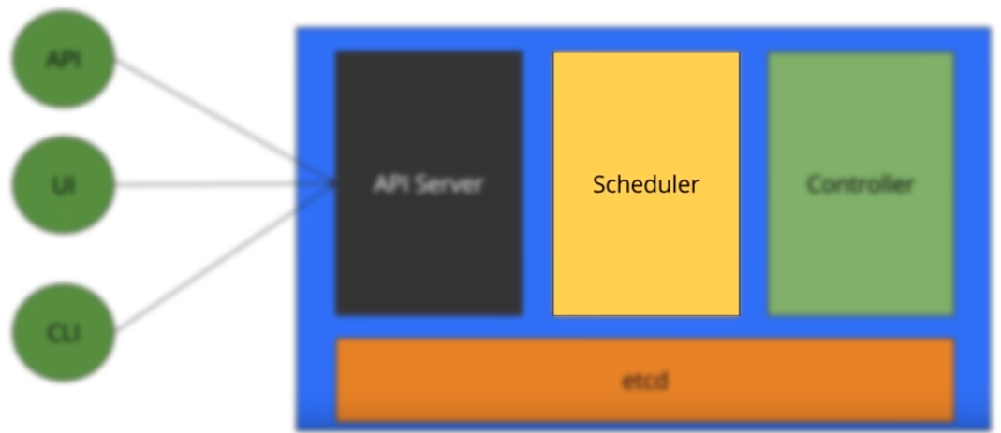
Kubernetes Parts & Components -1
Kubernetes Master
Scheduler
Kubernetes enables users to ask a cluster to run a set of containers.
The scheduler component automatically chooses hosts to run those containers on.
The scheduler watches for unscheduled pods and binds them to nodes via the /binding pod subresource API, according to
the availability of the requested resources,
quality of service requirements,
affinity and anti-affinity specifications,
other constraints.
Kubernetes supports user-provided schedulers and multiple concurrent cluster schedulers, using the shared-state approach
Two-level scheduling models that hide information from the upper-level schedulers need to implement all of the same features in the lower-level scheduler as required by all upper-layer schedulers in order to ensure that their scheduling requests can be satisfied by available desired resources.

Slide 23

Kubernetes Parts & Components -1
Kubernetes Master
Controller-Manager Server
Performs most other cluster-level functions
Performs both
Lifecycle functions
namespace creation and lifecycle
event garbage collection
terminated-pod garbage collection
cascading-deletion garbage collection
node garbage collection
API business logic
scaling of pods controlled by a ReplicaSet.
The application management and composition layer, providing self-healing, scaling, application lifecycle management, service discovery, routing, and service binding and provisioning.
These functions may eventually be split into separate components to make them more easily extended or replaced.

Slide 24
Kubernetes Parts & Components -1
AddOns
Add-ons extend the functionality of Kubernetes.
Some of the available add-ons based on function:
Networking and Network Policy
Calico: A secure L3 networking and network policy provider.
Canal: Unites Flannel and Calico, providing networking and network policy.
Cilium: A L3 network and network policy plugin that can enforce HTTP/API/L7 policies transparently, supporting both routing and overlay/encapsulation modes.
Contiv: Provides configurable networking for various use cases and a rich policy framework. It is fully open sourced.
Flannel: An overlay network provider that can be used with Kubernetes.
Romana: A Layer 3 networking solution for pod networks that also supports the NetworkPolicy API.
Weave Net: Provides networking and network policy, will carry on working on both sides of a network partition, and does not require an external database.
CNI-Genie: Enables Kubernetes to seamlessly connect to a choice of CNI plugins, such as Flannel, Calico, Canal, Romana, or Weave
Service Discovery
CoreDNS: A flexible, extensible DNS server which can be installed as the in-cluster DNS for pods.
Visualization & Control
Dashboard: A dashboard web interface for Kubernetes.
Weave Scope: For graphically visualizing your containers, pods, services etc.

Slide 25
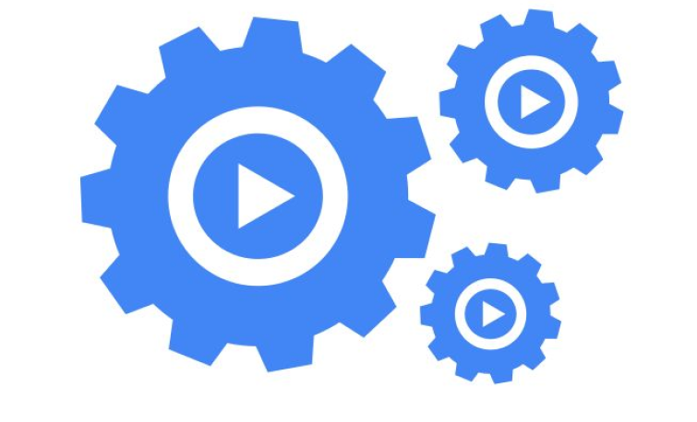
Kubernetes Parts & Components -1
Summary of container benefits:
Agile application creation and deployment: Increased ease and efficiency of container image creation compared to VM image use.
Continuous development, integration, and deployment: Provides for reliable and frequent container image build and deployment with quick and easy rollbacks (due to image immutability).
Dev and Ops separation of concerns: Create application container images at build/release time rather than deployment time, thereby decoupling applications from infrastructure.
CONTAINERS
Environmental consistency across development, testing, and production: Runs the same on a laptop as it does in the cloud.
Cloud and OS distribution portability: Runs on Ubuntu, RHEL, CoreOS, on-prem, Google Container Engine, and anywhere else.
Application-centric management: Raises the level of abstraction from running an OS on virtual hardware to run an application on an OS using logical resources.
Loosely coupled, distributed, elastic, liberated micro-services: Applications are broken into smaller, independent pieces and can be deployed and managed dynamically – not a fat monolithic stack running on one big single-purpose machine.
Resource isolation: Predictable application performance.
Resource utilization: High efficiency and density.

Slide 26
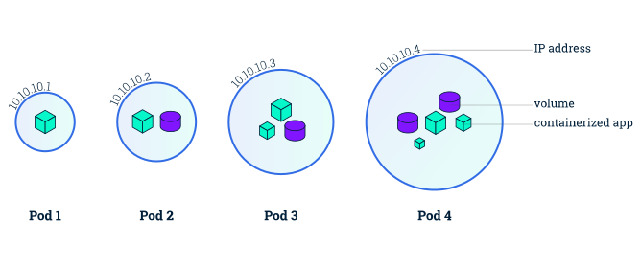
Kubernetes Parts & Components -1
Pods
Pods are the atomic unit on the Kubernetes platform
A Pod is a Kubernetes abstraction that represents a group of one or more application containers (such as Docker or rkt), and some shared resources for those containers.
Those resources include:
Shared storage, as Volumes
Networking, as a unique cluster IP address
Information about how to run each container, e.g. container image version, ports to use
A Pod models an application-specific "logical host" and can contain different application containers which are relatively tightly coupled
The containers in a Pod share an IP Address and port space, are always co-located and co-scheduled, and run in a shared context on the same Node.
When we create a Deployment on Kubernetes, that Deployment creates Pods with containers inside them
Each Pod is tied to the Node where it is scheduled, and remains there until termination or deletion.
In case of a Node failure, identical Pods are scheduled on other available Nodes in the cluster.

Slide 27
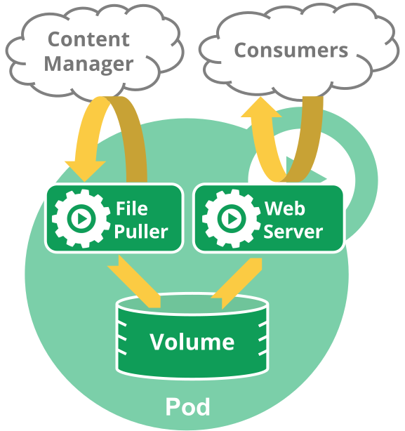
Kubernetes Parts & Components -1
Example, one container that acts as a web server for files in a shared volume, and a separate “sidecar” container that updates those files from a remote source
How Pods manage multiple Containers
Pods are designed to support multiple cooperating processes (as containers) that form a cohesive unit of service.
Each pod is isolated by
Process ID (PID) namespace
Network namespace
Interprocesss Communication (IPC) namespace
Unix Time Sharing (UTS) namespace
The containers in a Pod are automatically co-located and co-scheduled on the same physical or virtual machine in the cluster.
The containers can share resources and dependencies, communicate with one another, and coordinate when and how they are terminated.
Grouping multiple co-located and co-managed containers in a single Pod is a relatively advanced use case.
One should use this pattern only in specific instances in which your containers are tightly coupled.

Slide 28
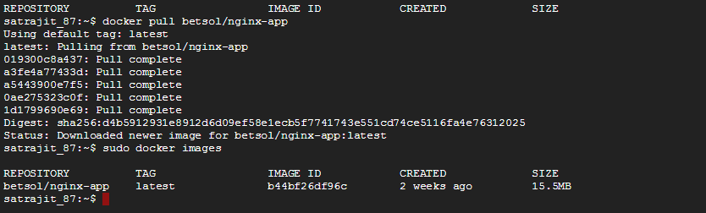
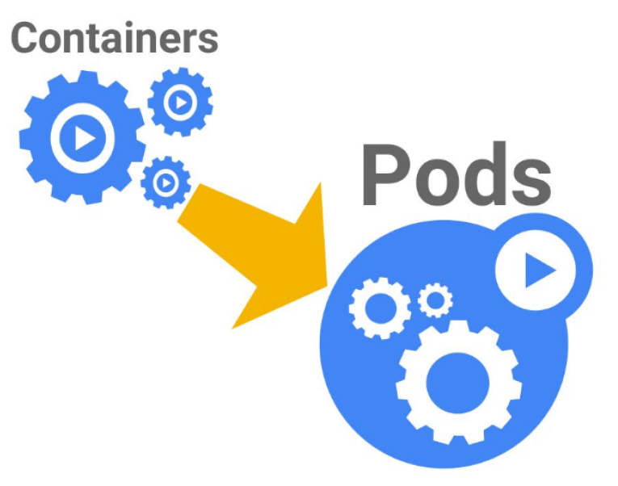
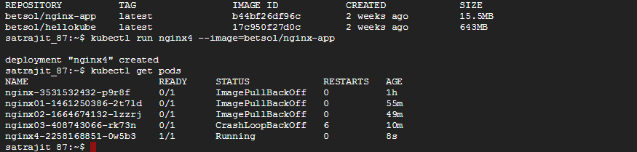
Kubernetes Demo – Create Pod
Get Container Image from Docker Hub
docker pull Betsol/nginx-app
Create Pod
kubectl run nginx4 –image=Betsol/nginx-app

Slide 29
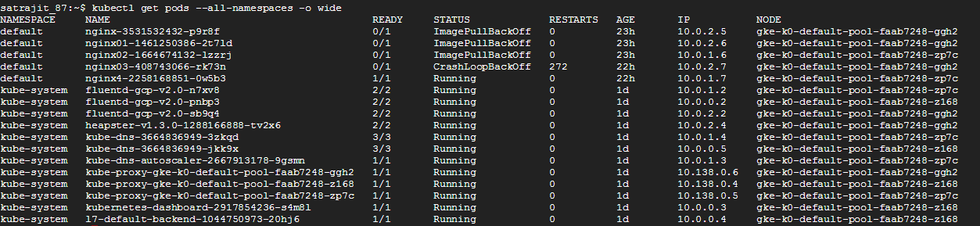
Kubernetes Demo – Get Pod Details
List Pods Across namespaces
kubectl get pods –all-namespaces –o wide

Slide 30
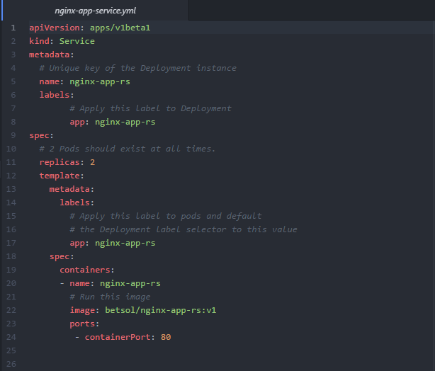
Kubernetes Parts & Components -1
Services
A Kubernetes Service is an abstraction which defines a logical set of Pods and a policy by which to access them
Sometimes called a micro-service.
The set of Pods targeted by a Service is (usually) determined by a Label Selector.
Kubernetes Pods are mortal. They are born and when they die, they are not resurrected.
Defining a Service

Slide 31
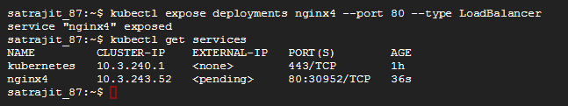
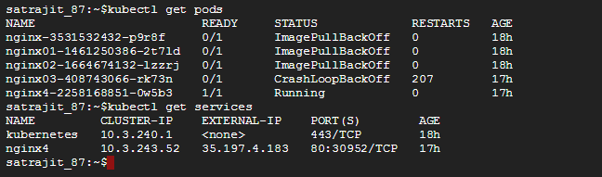
Kubernetes Demo – Create Service
Expose Pod/ Create Service
kubectl expose deployments nginx4 –port 80 –type LoadBalancer
List Service
kubectl get services

Slide 32
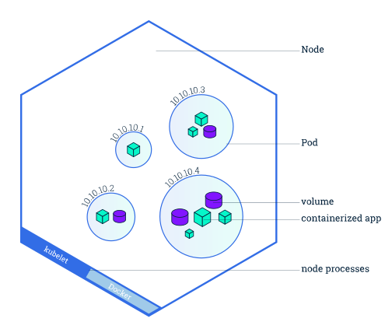
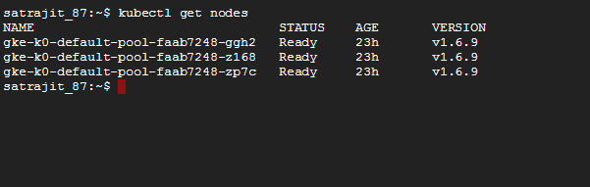
Kubernetes Parts & Components -1
Node
A node is a VM or a physical computer that serves as a worker machine in a Kubernetes cluster.
Each node has a Kubelet, which is an agent for managing the node and communicating with the Kubernetes master.
Each individual node runs two processes:
kubelet : which communicates with the master.
kube-proxy : a network proxy which reflects kubernetes networking service on each node.
List Nodes
kubectl get nodes

Slide 33
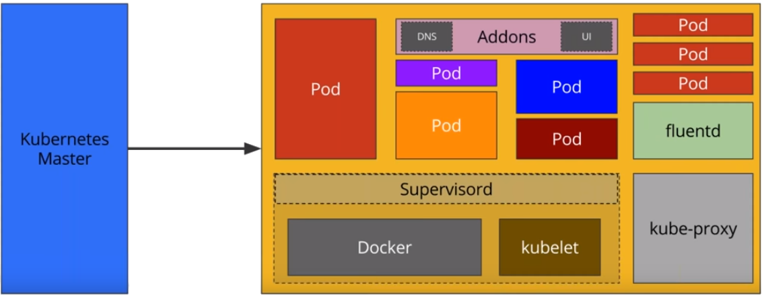
Kubernetes Parts & Components -1
Kubelet
The most important and most prominent controller in Kubernetes is the Kubelet
Primary implementer of the Pod and Node APIs that drive the container execution layer.
Kubernetes executes isolated application containers as its default, native mode of execution
Application containers isolated from each other
They are also isolated from the hosts on which they execute, which is critical to decoupling management of individual applications from each other and from management of the underlying cluster infrastructure.
Kubelet is the final arbiter of what pods can and cannot run on a given node
Kubelet also currently links in the cAdvisor resource monitoring agent.

Slide 34
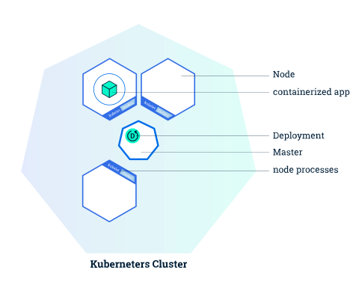
Kubernetes Parts & Components -1
Understanding Containers
Deployments
A Deployment is responsible for creating and updating instances of your application
Once a Kubernetes cluster is running, one can deploy containerized applications on top of it.
To do so, you create a Kubernetes Deployment configuration.
The Deployment instructs Kubernetes how to create and update instances of your application.
Once you've created a Deployment, the Kubernetes master schedules mentioned application instances onto individual Nodes in the cluster.
Once the application instances are created, a Kubernetes Deployment Controller continuously monitors those instances.
If the Node hosting an instance goes down or is deleted, the Deployment controller replaces it.
This provides a self-healing mechanism to address machine failure or maintenance.

Slide 35

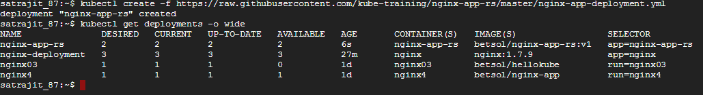
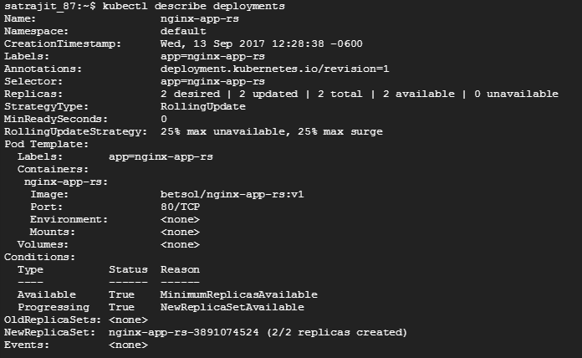
Kubernetes Demo – Create Deployment
Creating a Deployment
kubectl create –f https://raw.githubusercontent.com/kube-training/nginx-app-rs/master/nginx-app-deployment.yml
Defining a Deployment
Describing a Deployment
kubectl describe deployments

Slide 36
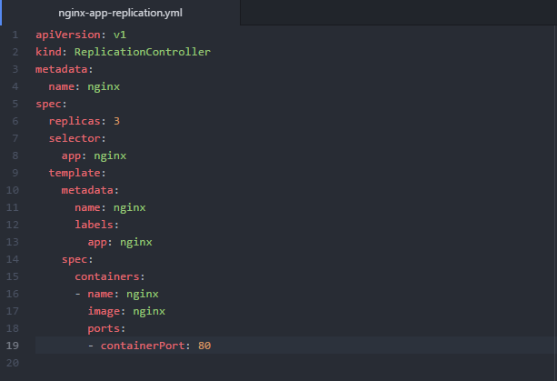
Understanding Containers
Kubernetes Parts & Components -1
Replication Controller
ReplicationController ensures that a specified number of pod replicas are running at any one time.
A ReplicationController makes sure that a pod or a homogeneous set of pods is always up and available.
Pods maintained by a ReplicationController are automatically replaced if they fail, are deleted, or are terminated.
A Deployment that configures a ReplicaSet is now the recommended way to set up replication.
Defining a ReplicationController

Slide 37
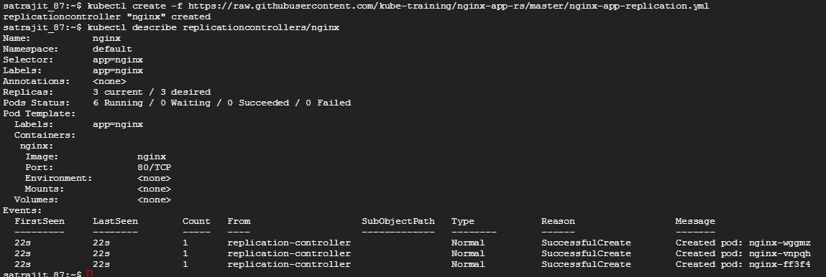
Kubernetes Demo – Create ReplicationController
Create and Describe ReplicationController
kubectl create -f https://raw.githubusercontent.com/kube-training/nginx-app-rs/master/nginx-app-replication.yml
kubectl describe replicationcontroller/nginx

Slide 38
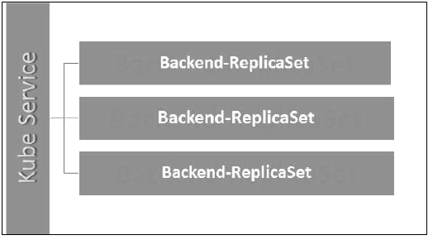
Kubernetes Parts & Components -1
Replica Sets
Replica Set ensures how many replica of pod should be running.
ReplicaSet is the next-generation Replication Controller.
The only difference between a ReplicaSet and a Replication Controller is the selector support.
ReplicaSet supports the new set-based selector requirements as described in the labels user guide
Replication Controller only supports equality-based selector requirements.
A ReplicaSet ensures that a specified number of pod replicas are running at any given time.
A Deployment is a higher-level concept that manages ReplicaSets and provides declarative updates to pods along with a lot of other useful features.
Therefore, it is recommended to use Deployments instead of directly using ReplicaSets, unless you require custom update orchestration or don’t require updates at all.
This means that you may never need to manipulate ReplicaSet objects

Slide 39
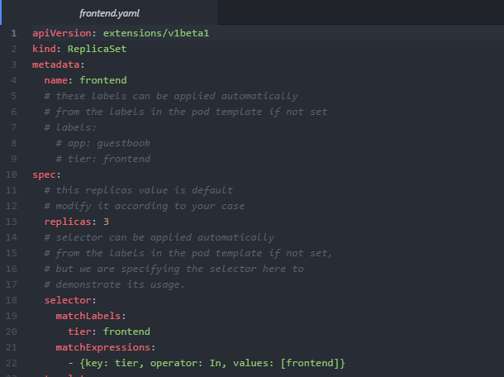
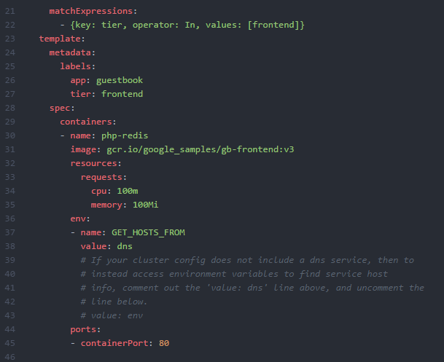
Kubernetes Demo – Define ReplicaSet
Defining a ReplicaSet

Slide 40
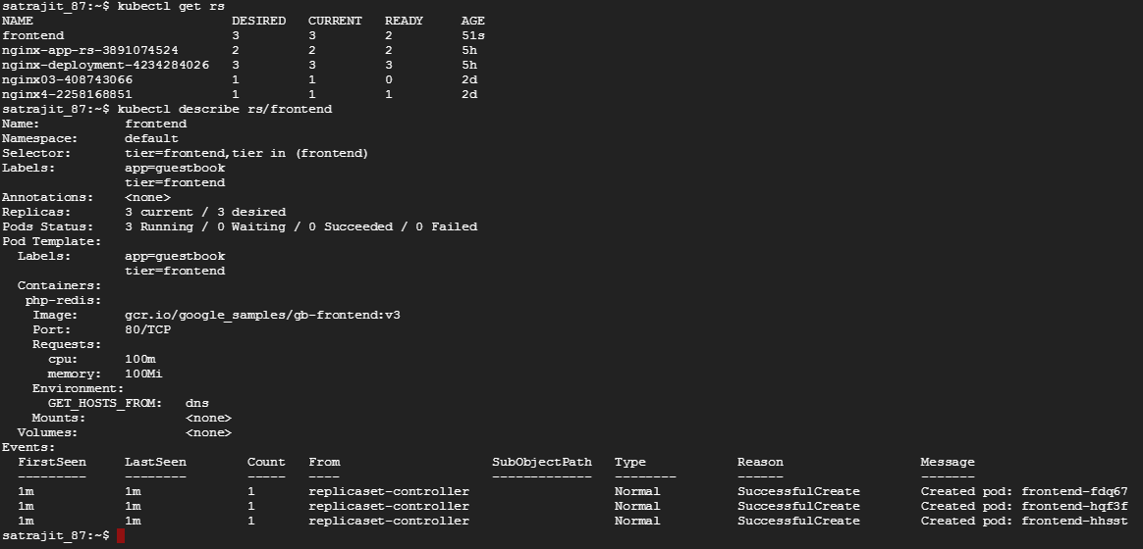
Kubernetes Demo – Create And List ReplicaSet
Create ReplicaSet
kubectl create –f https://raw.githubusercontent.com/kube-training/nginx-app-rs/master/frontend.yaml
List and Describe ReplicaSet
kubectl get rs
Kubectl describe rs/frontend
Deployment
kubectl describe deployments

Slide 41
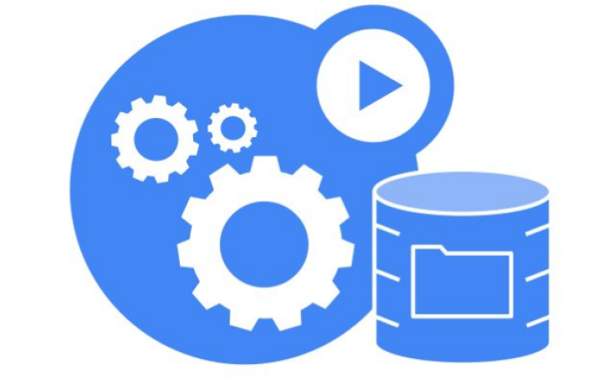
Kubernetes Parts & Components -1
Volumes
On-disk files in a container are ephemeral, which presents some problems for non-trivial applications when running in containers.
First, when a container crashes, kubelet will restart it, but the files will be lost - the container starts with a clean state.
Second, when running containers together in a Pod it is often necessary to share files between those containers.
The Kubernetes Volume abstraction solves both of these problems.
VOLUMES

Slide 42
Kubernetes Parts & Components -1
A Kubernetes volume has an explicit lifetime - the same as the pod that encloses it.
Consequently, a volume outlives any containers that run within the Pod, and data is preserved across Container restarts.
When a Pod ceases to exist, the volume will cease to exist, too.
More importantly, Kubernetes supports many types of volumes, and a Pod can use any number of them simultaneously.
At its core, a volume is just a directory, possibly with some data in it, which is accessible to the containers in a pod.
Volume Type used, determines how that directory comes to be, the medium that backs it, and the contents of it.
VOLUMES

Slide 43
Kubernetes Parts & Components -1
Kubernetes supports several types of Volumes:
emptyDir
hostPath
gcePersistentDisk
awsElasticBlockStore
nfs
iscsi
fc (fibre channel)
flocker
glusterfs
rbd
cephfs
gitRepo
secret
persistentVolumeClaim
downwardAPI
projected
azureFileVolume
azureDisk
vsphereVolume
Quobyte
PortworxVolume
ScaleIO
StorageOS
local

Slide 44
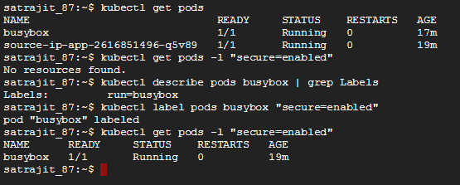
Understanding Containers
Kubernetes Parts & Components -1
Labels & Selectors
Key/value pairs that are attached to objects, such as pods.
Intended to be used to specify identifying attributes of objects that are meaningful and relevant to users, but do not directly imply semantics to the core system.
Used to organize and to select subsets of objects.
Can be attached to objects at creation time and added and modified at any time.
Each object can have a set of key/value labels defined.
Each Key must be unique for a given object.
Labels are the essential glue to associate one API object with other
Replication Controller -> Pods
Service -> Pods
Pods -> Nodes

Slide 45
Kubernetes Architecture - Service communications
apiserver -> nodes, pods, and services
apiserver -> kubelet
The connections from the apiserver to the kubelet are used for:
Fetching logs for pods.
Attaching (through kubectl) to running pods.
Providing the kubelet’s port-forwarding functionality.

Slide 46
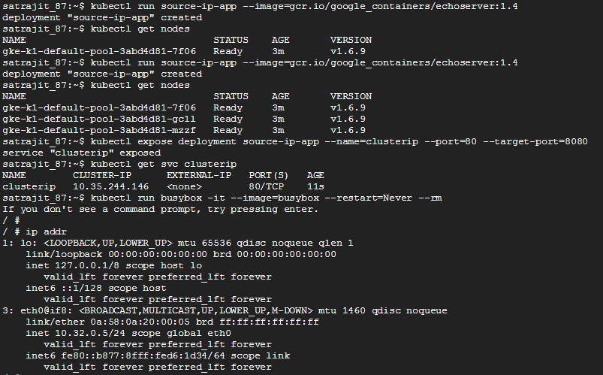
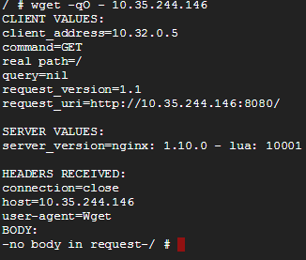
Kubernetes Architecture - Service communications

Slide 47


